Slide 1
OFFICIATING PICKLEBALL
In
2024

Slide 2
RECORD!!

Slide 3
2024 Referee Training
Presented by:
Alan Thomson
Pickleball Canada/USA
Certified Referee
&
Head Referee for Canada

Slide 4
Based On
2024
USA Pickleball Rulebook
&
Officiating Handbook
(Best Practices)

Slide 5
3 SESSIONS - SESSION 1
Five Topics
Responsibilities & Code of Conduct
Pre-Match Preparation
Scoresheet Familiarization & Marking
Breaks in Play & Scripts
Match & Scoresheet Completion
Notes:
Red = 2021 Rule Change in Sections 1. - 3.
Use the sections which are appropriate to your audience. e.g. Working with Line Judges is not relevant to new referees and an update session with experienced referees may not need to review Section 1..

Slide 6
SESSION 2
Four Topics
Common On-Court Situations
Disciplinary Process & Scoresheet Marking
Less Common On-Court Situations
Dual Referee System

Slide 7
SESSION 3
Three Topics
Working with Line Judges
2024 Rule Changes
Trainee to Accredited to Certified Referee

Slide 8
Managing Expectations
What should you expect to learn today?
HOW TO:
Handle yourself on the court
Handle clipboard & scoresheet
MARK the scoresheet
Make immediate calls
Point, 2nd Server, & Side-Out

Slide 9
REFEREEING
PICKLEBALL
IS AN
EXERCISE IN
MANAGING DETAILS!

Slide 10
Key Definitions & Terms
3.A.3 Court – The area inside the outer dimensions of the baselines and sidelines.
3.A.26 Playing Surface – The court and the area surrounding the court designated for playing. (The area inside the a fenced Court)
3.A.19 Live Ball/In Play – The point in time when the referee or server (or server's partner) starts to call the score.
3.A.5 Dead Ball – A ball that is no longer in play. A ball that has bounced twice or has hit a fixed object.

Slide 11
Key Definitions & Terms
End of court – The Court & Playing Surface, the space between the net and baselines for both teams/players.
Side of court – The left or right side of the court, also known as the odd (left) side & even (right) side of the court
3.A.39 Starting Server – For each doubles team, the player designated to serve first at the start of the game. In doubles tournament play, the starting server shall wear a visible form of identification determined by the Tournament Director.
3.A.12 First Server – In doubles, the player who shall serve from the right/even side of the court after a side out, according to the team’s score.

Slide 12
SESSION 1
TOPIC 1
RESPONSIBILITIES
&
CODE OF CONDUCT

Slide 13
Code of Conduct
Professional with pleasant demeanor
Be respectful
Avoid over friendliness
Avoid emotional reactions
Do not comment on play
Avoid anger or confrontation

Slide 14
Code of Conduct (cont’d)
Enforce rules in accordance with best practices
Avoid being dictatorial
Devote full attention
Stand and be attentive
Avoid leaning on walls or fences

Slide 15
Code of Conduct (cont’d)
Do not use or carry any device that could interfere with play
Silence your phone
Excuse yourself from refereeing family, close friends, doubles partners

Slide 16
Code of Conduct (cont’d)
Referee Compliance Policy Document (Draft)
Ensuring all Credentialed Referees administer the Rules appropriately & adhere to the Best Practices
Holding Referees accountable for their actions
Held to a higher standard than that of a PC member
Warnings to suspension and even loss of credentials is possible

Slide 17
Code of Conduct (cont’d)
Be what you would like your Referee to be.
The Referee is a facilitator.
The match is about the players and the game.

Slide 18
Primary Responsibilities
Keep and announce correct score
Track correct server and recognize server & receiver positioning
Call service and no-volley zone (NVZ) Faults
Maintain control and keep the match moving efficiently

Slide 19
Primary Responsibilities (cont’d)
Recognize violations, enforce rules and resolve disputes
Rule on line calls only when requested by a player
Issue Verbal Warnings, and call Technical Warnings and Technical Fouls as appropriate

Slide 20
SESSION 1
TOPIC 2
PRE-MATCH
PREPARATION

Slide 21
Pre-Tournament Procedures
Review the current USA Pickleball Rules
Review the Pickleball Referee Handbook
Recommend completing online tests:
Player Rules
Referee Rules
Best Practices
Line Judge

Slide 22
Tournament Day Preparation
Before the match:
Prepare mentally & physically
Pick up tools in advance
Know venue court layout

Slide 23
Pre-Match Preparation
Pick up scoresheet & activate timer immediately when called/texted
Review scoresheet:
Player names – conflict of interest?
Court number
Match format
End change notation?
“1” or “2” on back of scoresheet?
Proceed to court without delay
Notes:
23

Slide 24
Pre-Match Courtside
Enter/exit court with players
Identify safety hazards/obstacles
Check portable net positioning
Confirm net height
Pickup anything on the court

Slide 25
Pre-Match Courtside (cont’d)
Two starting server armbands
Two official balls for match
Choose your on-court position
Consider sun, shadows, distractions, spectators, Line Judges, etc.

Slide 26
Pre-Match Briefing
Require Players’ Undivided Attention
Introductions
Paddle checks
State match format
Review line calling responsibilities
Determine end/serve/receive or defer

Slide 27
Pre-Match Briefing (cont’d)
Identify each team’s Starting Server
Tailor briefing to circumstances and players’ experience
Begin/continue warm up – indicate remaining time
Give “1 Minute” notice

Slide 28
SESSION 1
TOPIC 3
SCORESHEET PREPARATION
&
MARKING TECHNIQUE

Slide 29
Preparing the Scoresheet
Mark serving team for each game
Circle starting server each team
Record identifying characteristics
Confirm/make end-change notations

Slide 30
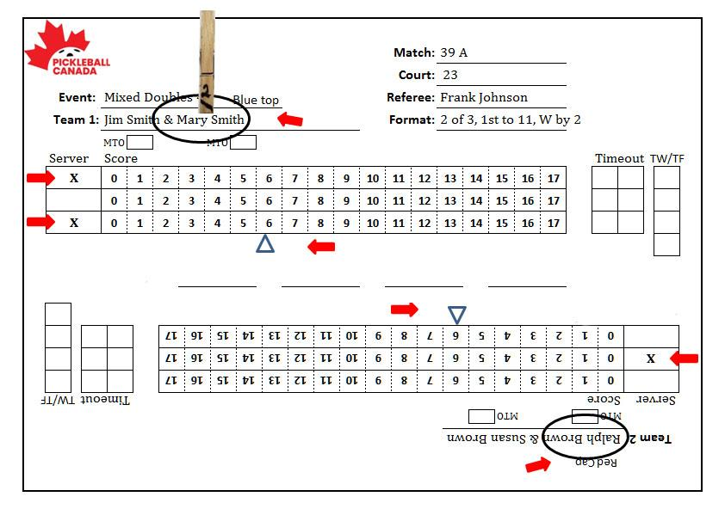
Preparing the Scoresheet
Starting Server - Serving Team - Change @ 6

Slide 31
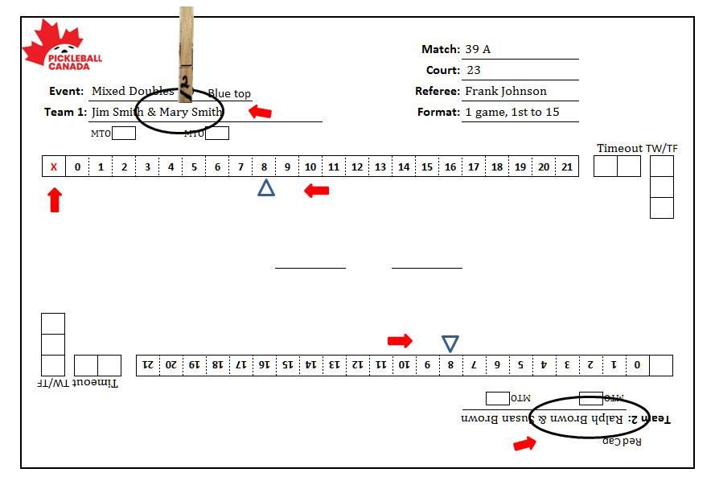
Preparing the Scoresheet
Starting Server - Serving Team - Change @ 8

Slide 32
Final Pre-Play Procedure
Point clipboard clip toward serving team
Server clip over circled starting server name with # 2 facing you
Establish position 3 to 4 ft directly behind the net post

Slide 33
Final Pre-Play Procedure (Cont’d)
Confirm teams by name (beginning of match only)
Visually verify server bands and player positioning (band serves to band)
At T-0, announce Game #, “Time In” and call the score
Use of Arm - recommended
Notes:
The only time band will not serve to band at the beginning of the game is when a TF between games has resulted in awarding a point to the non-offending team. e.g. Team 1 is serving first in the 2nd game. They committed a TF between games 1 and 2, so Team 2 starts the game with a score of 1 and will hopefully line up appropriately.

Slide 34
Final Pre-Play Procedure (Cont’d)
How Arm should be used
When Players in position Raise Arm
Ensure server has ball and is ready
Looking at Receiver, start calling the score
While continuing to call score turn head quickly to watch server for any violations
On completion of calling score, drop hand quickly
Notes:
The only time band will not serve to band at the beginning of the game is when a TF between games has resulted in awarding a point to the non-offending team. e.g. Team 1 is serving first in the 2nd game. They committed a TF between games 1 and 2, so Team 2 starts the game with a score of 1 and will hopefully line up appropriately.

Slide 35
Final Pre-Play Procedure (Cont’d)
How Arm should be used
Why use the arm in this manner?
Let’s everyone know the score is about to be called.
Watch Receiver to ensure they do NOT become unready… arm in air, turn their back to net.
Know complete score has been called when hand drops
Notes:
The only time band will not serve to band at the beginning of the game is when a TF between games has resulted in awarding a point to the non-offending team. e.g. Team 1 is serving first in the 2nd game. They committed a TF between games 1 and 2, so Team 2 starts the game with a score of 1 and will hopefully line up appropriately.

Slide 36
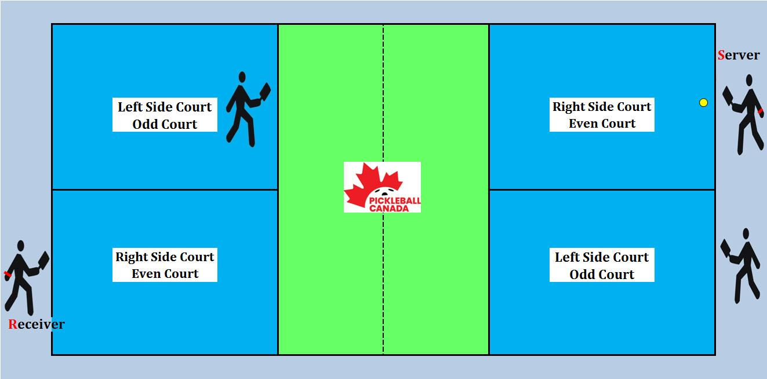
Correct Player Position

Slide 37
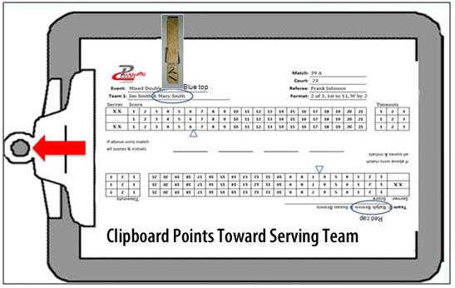
Clipboard Clip Toward Serving Team
Notes:
37

Slide 38
Prior To Every Serve
Confirm Readiness
First look at receiver & partner
Ready? Or should be ready?
Look at server & partner
Ready? Or should be ready?
Based on the score and server bands mentally confirm - are the server and potential receiver correct

Slide 39
Prior To Every Serve (cont'd)
NEW
Prior to calling the score and based on the score
Verify all player’s positioning
If incorrect put everyone into their correct position
Call the score
Notes:
39

Slide 40
Prior To Every Serve (cont'd)
Any Player May Still Ask:
“What is the score?”
“Am I the correct server/receiver?”
“Am I in the correct position?”
“Am I Good?”
Answer the question and again ensure all players are in the correct position.
Notes:
40

Slide 41
Prior To Every Serve (cont'd)
If you have called the score, and the ball has not been served;
Step forward, raise arm Call “Stop Play”
Answer the question
Announce you will recall the score
Step back, lower arm and recall the score, starting a new 10 second count
Notes:
41

Slide 42
Prior To Every Serve (cont'd)
Announce score clearly, loudly and with consistent cadence
Begin 10 second count
Any player may signal ‘Not Ready’ prior to the start of the score being called
After the score is called, ignore ‘Not Ready’ signals

Slide 43
The Serve
Watch for service Faults
Foot Faults – baseline + imaginary extensions
Illegal serves
Drop Serve propelled (fault) or drop not visible (re-serve)
Visually follow ball to receiving court, watching for short serves that do not clear the NVZ and NVZ lines. – Call “FAULT"

Slide 44
The Serve (cont’d)
Serve Timing
Serving the ball before the complete score has been called is a Fault.
Serving the ball prior to the score being called is a re-serve. (Ball is Dead until the Referee starts to call the score.)
The serve is defined as the initial strike of the ball to start the rally.

Slide 45
The Serve (cont’d)
Ten second rule note:
Any 10 second violation results in a Fault against the server.
A served ball may clear or touch the net and must clear the NVZ and NVZ lines.
A served ball touching receiver or receiver’s partner before landing is a point for the serving team (even if the partner is clearly standing out of bounds)

Slide 46
During Play
Call every Fault
Immediately
Loudly
Confidently
Followed by:
“Point” or
“Second server” or
“Side out”

Slide 47
During Play (Cont’d)
When a volley is hit from close to the NVZ:
Do not follow flight of volleyed ball
Focus on NVZ for faults until momentum is under control
If the ball bounces prior to being hit, NVZ faults are not in effect
Watching the NVZ is a primary responsibility

Slide 48
Scoresheet Marking / Recording
It’s all about leaving tracks for recreating what has happened and where you are.
You should be able to look back and confirm the play as it happened.
Recreate how the score developed.
Do it right, do it well, do it every time.

Slide 49
Marking Points On The Scoresheet
Record every point as it occurs
Use appropriate diagonals in score box based on server
1st server points = forward slash /
2nd server points = backslash \

Slide 50
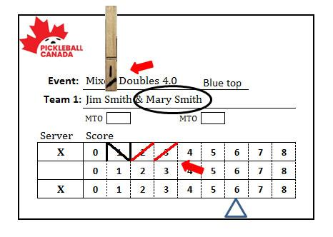
Marking Points On The Scoresheet (cont’d)
First server points are marked upper right to lower left

Slide 51
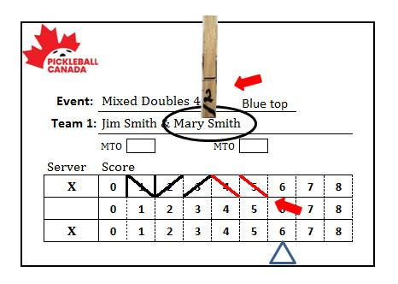
Marking Points On The Scoresheet (cont’d)
Second server points are marked upper left to lower right
Notes:
remove side out line and make second server point in 4 and 5 red.

Slide 52
Move The Clip
Move and flip the clip on every change in server and every side out

Slide 53
At Side Out
After making vertical side out slash:
Rotate clipboard so board clip is toward new serving team
Reposition server clip to correct server with #1 facing you, based on odd or even score
Be as efficient as possible

Slide 54
Marking Side-Out
If side out occurs at start of the game with no points, vertical mark right of
score 0.

Slide 55
Marking Side-Out
If points were scored make vertical mark right of last point

Slide 56
Questions?

Slide 57
SESSION 1
TOPIC 4
BREAKS IN PLAY
&
SCRIPTS

Slide 58
Timeout Procedure
Acknowledge team requesting the timeout
Activate timing device
Announce score
Announce “1 Minute”
Move to centre court to avoid interaction with either team or spectators

Slide 59
Timeout Procedure
SCRIPT
Time-Out
Receiver(s)/Server(s)
4-0-2 (Score)
1 minute

Slide 60
Timeout Procedure (cont’d)
Advise players when 15 seconds remain
If working with line judges, ensure they are ready
If player has left court with paddle, re-inspect before resuming play (Not necessary if you observed them outside of the court)
Remain at Ctr Crt and ask players if they are ready to proceed. Give remaining T/O
Return to position behind net post

Slide 61
Timeout Procedure (cont’d)
Notify teams of number of remaining timeouts
Call “Time In”
Announce score
Start 10 second count
Failure to serve within 10 seconds = Fault

Slide 62
Timeout Procedure (cont’d)
SCRIPT to restart play
15 Seconds
Line Judges Ready
Point to receiving team – “1 T/O Remaining”
Pointing to Serving Team – “2 T/O”
Time IN (Ensure everyone in correct position)
6-4-2

Slide 63
Timeout Rules
Cannot be used to delay the start of the first game of a match
Can be taken between games in best 2 out of 3 format
Can request both timeouts at start of 2nd or 3rd game. If both not required, 1 remains for later use.
Can be called after score is called
Cannot be called after the ball is struck
CAN be used to extend a MTO

Slide 64
Marking Timeouts On Scoresheet
Mark the game score in the appropriate timeout box
Separate team scores using same diagonal slash as on server clip
1st server = forward slash /
2nd server = backslash \

Slide 65
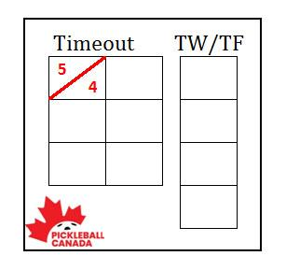
Timeout Example 1
Server scores are recorded above the line
Timeout called by Team 1 when serving at
5-4-1

Slide 66
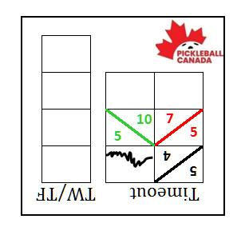
Timeout Example 2
Server scores are recorded above the line
Timeouts called by Team 1 while receiving at
7-5-1 &
10-5-2
Scoresheet purposely NOT rotated

Slide 67
Between Games (Best 2/3)
Announce the final score
Start timing device and announce “Two Minutes”
Call Time Out
Collect and hold game ball
Move to centre court & prepare scoresheet for next game

Slide 68
Between Games (Best 2/3)
SCRIPT – END OF GAME
Point, Game, Score, (winning players) Names
Time Out
Change Ends
2 minutes
(Move to centre court with head up watching players move off the court!)

Slide 69
Between Games (Best 2/3) (cont’d)
Prepare scoresheet for next game
Draw horizontal lines through previous game’s unused score & timeout boxes
Circle or lightly shade the box containing the final point scored by each team

Slide 70
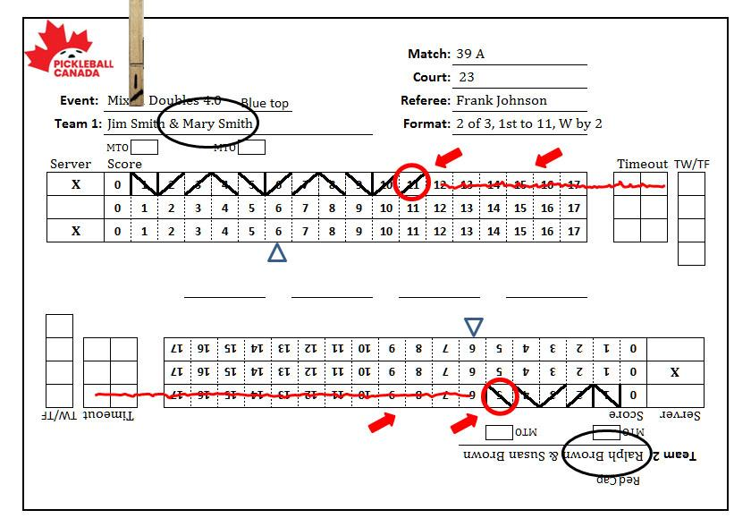
Between Games (Best 2/3) (cont'd)
Draw line through unused spaces at end of every game (except final)

Slide 71
Between Games (Best 2/3) (cont'd)
Circle or lightly shade the final point scored by each team

Slide 72
Between Games (Best 2/3) (cont'd)
Rotate clipboard so board clip is facing serving team
Rotate scoresheet accordingly
Place server clip (side #2) above starting server’s name
Note starting server for each team (Have they changed? If so, ask the team)

Slide 73
Between Games (Best 2/3) (cont'd)
At 1:45 loudly notify both teams that 15 seconds remain
Return to Referee Position
Game may begin earlier if all players are ready and agree
Return ball to serving team

Slide 74
Between Games (Best 2/3) (cont'd)
SCRIPT
15 SECONDS
(Line Judges Ready)
Game # 2
Time IN
0-0-2

Slide 75
Between Games (Best 2/3) (cont'd)
If third game, remind players of upcoming end change
At the end of two minutes, call “Time In” and the score – even if players are not in position
NB: Give players time to get into position if moving that way!
Start the 10 second count
Failure to serve by the end of the 10 seconds
is a Fault

Slide 76
End Change Procedure
At 6, 8, or 11 points
Call “Point
Call “Timeout”
”End Change”
State score & announce “1 minute”
Start 1 minute timer
Move to centre court
Mark scoresheet that change has been made

Slide 77
End Change Procedure
SCRIPT
Point
Time Out
Change Ends
6-5-1 (8-4-2)
1 minute

Slide 78
End Change Procedure (cont'd)
Before removing server clip, mark “1” or “2” next to current server’s name, based on server clip number
Rotate scoresheet and clipboard
Replace server clip over server name based on “1” or “2” as noted

Slide 79
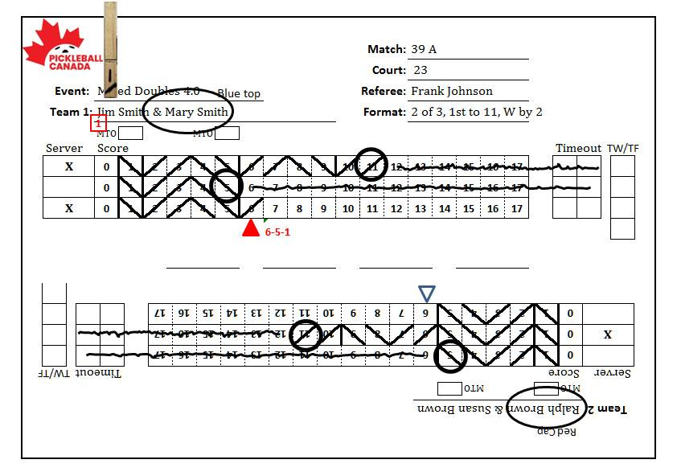
End Change Procedure (cont'd)
Notes:
While not required, many referees will shade the triangle and note the score beside it as an aid in remembering the change was made and what the score was.

Slide 80
End Change Procedure (cont'd)
At 45 seconds, loudly notify both teams that 15 seconds remain
Assume Referee position by end of 1 minute
State “Time In”
Call score & start 10 second count
Failure to serve by end of the 10 seconds = Fault

Slide 81
End Change Procedure (cont’d)
Timed 1 minute allowed
Conversation between partners is permitted
Hydration is permitted
Coaching is permitted

Slide 82
SESSION 1
TOPIC 5
MATCH
& SCORESHEET COMPLETION

Slide 83
At Completion Of Match
SCRIPT
Announce: “Point, Game, Match”
and give the NAMES of Winning team
final game score.
“11-6”

Slide 84
At Completion Of Match (Cont’d)
On The Scoresheet
Circle/Shade final point scored by each team
Write “Winners” by winning team’s names and circle both
With Winners names up, record scores of all games in the order they occurred on central scores line and with winners scores first
Mark game scores accurately and legibly
Have winning team member confirm they are the winners, scores and initial

Slide 85
At Completion Of Match (Cont’d)
Re-check your work before turning in
Without delay, return clipboard and scoresheet to the Referee desk
Incorrect player or position error may be corrected until the scoresheet is turned in.

Slide 86
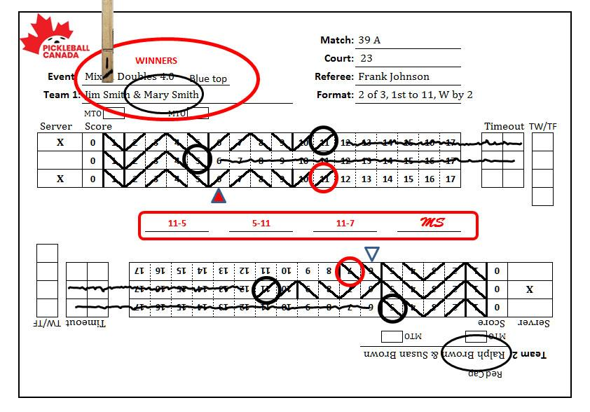
Completed Scoresheet (2/3)
Circle winners, write “Winners”
Write scores on score line.
Get initials.

Slide 87
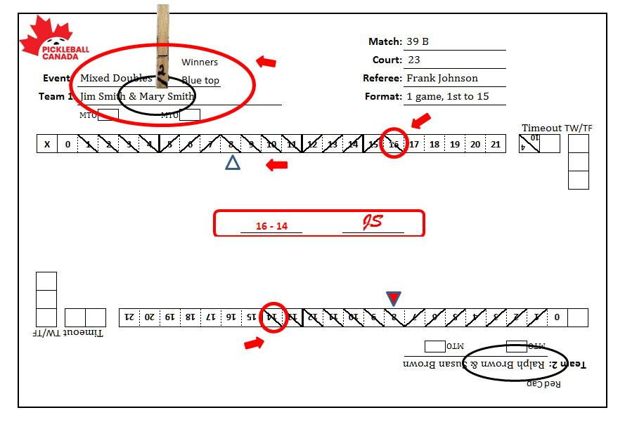
Completed Scoresheet (1 to 15)
Circle winners, write “Winners”.
Write score on score line.
Get initials.

Slide 88
THE END
OF
SESSION 1

Slide 89
Questions?

Slide 90
SESSION 2
Common On-Court Situations
Disciplinary Process & Scoresheet Marking
Less Common On-Court Situations
Dual Referee System

Slide 91
SESSION 2
TOPIC 1
Common
On-Court
Situations

Slide 92
Portable Net Rules
Ball strikes horizontal bar or centre base before going over net = Fault
Ball goes over net and hits center base, horizontal bar or gets caught before landing = Replay
Ball bounces with enough backspin (after going over net) to hit the horizontal bar prior to the second bounce = Replay

Slide 93
Standard Serve
To be legal, the ball must be contacted:
In an upward motion with arc
Paddle below the waist
Highest point of the paddle head below the wrist break

Slide 94
Service Rule Changes in 2023
Spinning the ball with the hand is not permitted when serving the ball!
The Referee can order a Replay for serves that they are not certain comply with the service rules.
Announce ”Stop Play, possible illegal Serve”
The Referee will call an immediate FAULT if a serve clearly violates one or more of the requirements.

Slide 95
Drop Serve
Server may release the ball from any unaided height
drop from hand or paddle
may not propel or toss or hit the ball upward
ball must be hit after it bounces on the playing surface (one or more times).
The server’s release of the ball must be visible to the referee and the receiver.
call a replay before return of the served ball, if it is not visible

Slide 96
Drop Serve (Cont’d)
The three required elements of a conventional serve do not apply.
Failure to release the ball properly = Replay or Fault
Rules regarding feet placement do apply.

Slide 97
Server Out of Position or Wrong Server
Correct position immediately
Do not wait for players to ask, tell them immediately that “you are not the correct server!”

Slide 98
Serving Before Complete Score Is Called
Call “Service Fault” followed by “Second Server” or “Side Out.”
Could deviations in your cadence have contributed to this Fault?
If so, call for a replay!

Slide 99
Server Foot Faults
Call “Foot Fault,” “Right Foot,” immediately upon violation, followed by “Second Server” or “Side Out.”
Do not elaborate or debate

Slide 100
NVZ Violations (repeated)
Primary responsibility during and following a volley
Includes the player’s momentum:
Momentum ends when the player regains balance and control of their motion or stops moving toward the NVZ
Anything the player is wearing, carrying or contacting touches the NVZ
Call “Fault” immediately

Slide 101
Referee Error Correction
Referee or any player may stop play before return of serve to correct the score.
It is a FAULT to stop play after the return of serve to identify or ask for a score correction.
It is a FAULT to stop play to identify or ask for a score correction when the score was correctly called.
NVZ foot fault called on bounced ball – Call “Stop Play ” immediately, announce “Referee Correction” and call for a replay.

Slide 102
Player Readiness
Following dead ball, players are expected to move to respective positions without delay
Call score when all players are ready
Allow receiver reasonable time to become ready
If delaying:
You may warn the player about their slow play
Call score when all players should be ready and begin 10 second count

Slide 103
Stacking
Concentrate only on proper server and receiver
based on:
Score
Starting server identification
Distinguishing features
Server clip - first or second

Slide 104
Questions/Discussions
Keep both sides equally informed
Conference at center court to avoid spectator input
Invite player(s) from both teams to avoid perception of one team gaining advantage

Slide 105
Questions/Discussions (cont’d)
If discussion become intense or continue:
Cut it off
Send all parties to neutral corners
Give 15 second warning
Call “Resume Play” and announce score

Slide 106
Challenged Calls/Rulings
When requested or necessary to resolve dispute summon Head Referee or Tournament Director
If Referee’s ruling is correct, disputing team:
Loses one regular timeout and is assessed Technical Warning
No timeouts left - assess a Technical Foul

Slide 107
Broken Ball
Play continues to completion of rally
Fault if player stops play due to broken ball
VW or TW if player crushes ball without allowing it to be examined
Before the next serve, player can ask Referee to determine if cracked ball affected outcome (replay possible at Referee’s discretion)

Slide 108
Line Calls
Upon appeal, overrule if 100% positive of where the ball hit.
Do not say “I think…” State ruling clearly & firmly, “The ball was in/out”.
The moment a player/team appeals to the Referee or asks the opponent’s opinion, they lose their right to make a subsequent “In” or “Out” call regarding that rally.
If the Line Judges and Referee cannot make a line call, the rally shall be replayed.

Slide 109
Spectators And Coaching
Coaching is any communication that a player or team may act upon (direction) to gain an advantage or avoid rules violation.
Depending on circumstances, the Referee may award a VW, or TW
Coaching is permitted only during timeouts, end changes & between games.
NOTE: Do not approach the Spectator who is coaching! Deal with the team being coached!
Notes:
including electronic

Slide 110
Medical Timeout (MTO)
Upon request, summon medical personnel to assess validity of request
Start timer when medical personnel arrive
15 minutes or less per player per match, but only ONE self-requested MTO
Mark (X) the ‘MTO’ box below the player’s name

Slide 111
Medical Timeout (cont’d)
Record details on back of scoresheet without removing scoresheet from clipboard
If request is not valid
Assess regular timeout and issue Technical Warning
Issue Technical Foul if no timeouts remaining
Medical timeout no longer available to requesting player
May be initiated by the referee

Slide 112
Other Time Out Rules (10.H.)
Extenuating Circumstances 10.H.2
Player may not be aware of own problem
Referee can ask for medical assessment
If no issue is found – game continues
Medical TO is NOT charged- consider it a Referee TO.
No time limit stated – “May require and extended interruption of play!”
Notes:
If no medical TO available, consider it a referee TO

Slide 113
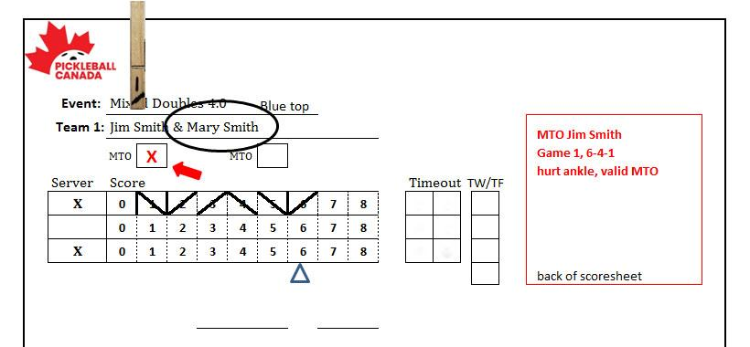
Medical Timeout (cont’d)
Notes:
If no medical TO available, consider it a referee TO

Slide 114
Equipment Timeout
At Referee's discretion
Players are NOT required to use a regular Time-out for equipment adjustment or changes.
The Referee will call an equipment time-out of a reasonable duration.

Slide 115
Questions?

Slide 116
SESSION 2
TOPIC 2
Less Common
On-Court
Situations

Slide 117
SESSION 2
TOPIC 2
DISCIPLINARY PROCESS
&
SCORESHEET MARKING

Slide 118
The Disciplinary Process
Referees are empowered to issue different levels of discipline to maintain control of a match.
The guiding rule should be to use the lowest level of discipline to stop the undesirable behaviour.
The formal disciplinary steps range from a Verbal Warning, to Technical Foul.
Simply letting a player know you are listening/paying attention may be enough to prevent similar behaviour, in the future.

Slide 119
Verbal Warnings
The first step in the formal disciplinary process
Should be used early in the match to eliminate unwanted behaviours.
Profanity, slow play, or unsportsmanlike conduct.
1 VW per Team/Player/Match
Can be issued after a TW or TF

Slide 120
Technical Warnings
Referees are empowered to issue
A Technical Warning - typically precedes a Technical Foul
A second Technical Warning in a match (by either partner, for any reason) equals a Technical Foul

Slide 121
Technical Warnings (cont'd)
Document the Technical Warning:
Record “TW” in the appropriate team’s TW/TF box
Record details on back of scoresheet
Two technical warnings = one technical foul

Slide 122
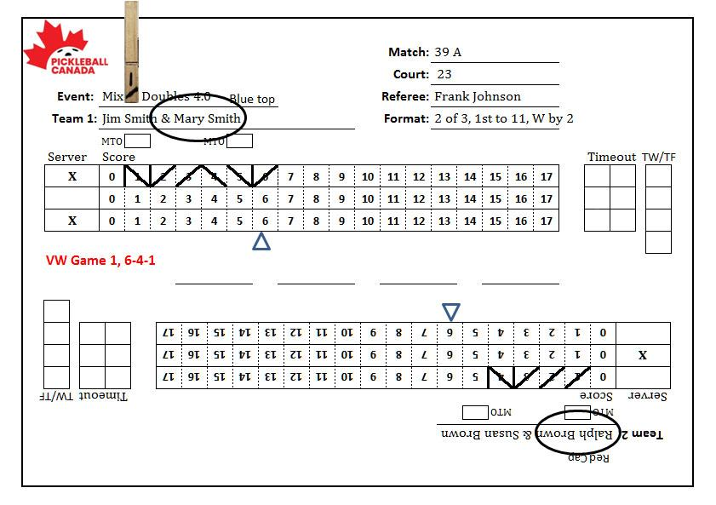
Verbal Warning Example

Slide 123
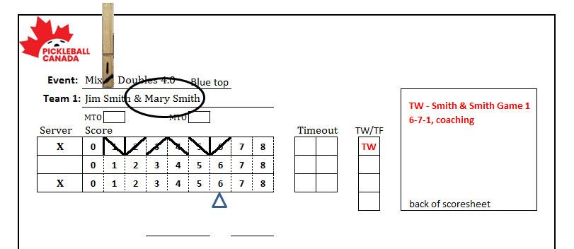
Technical Warnings (cont'd)
One Technical Warning example:
Notes:
No adjustment to score

Slide 124
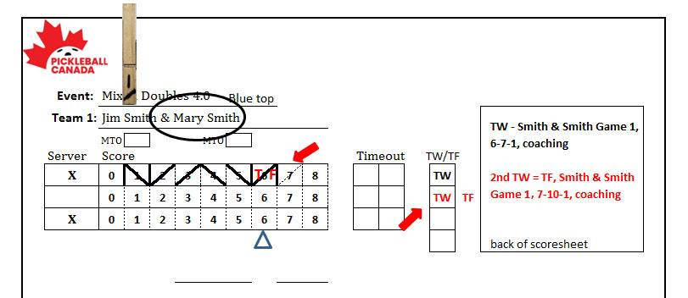
Technical Warnings (cont'd)
Two Technical Warnings = TF example:

Slide 125
Technical Fouls
Warranted For:
Aggressively or recklessly throwing paddle
Hitting a person with a ball not in play
Extreme objectionable language
Threats or challenges
Losing Referee challenge when no timeouts available
Extreme unsportsmanlike behaviour
Notes:
If paddle hits someone - eject from tournament

Slide 126
Technical Fouls (cont'd)
After Technical Foul is issued
Deduct one point from offending team’s score.
Erase last point recorded on scoresheet and adjust the side-out line.
Record “TF” in the appropriate team’s TW/TF box
Record details on back of scoresheet
Notes:
If offending team has 0 score, add 1 to non-offending team score

Slide 127
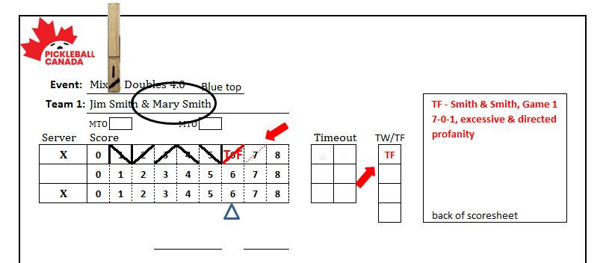
Technical Fouls (cont'd)
One point subtracted from offending team
Notes:
If offending team has 0 score, add 1 to non-offending team score

Slide 128
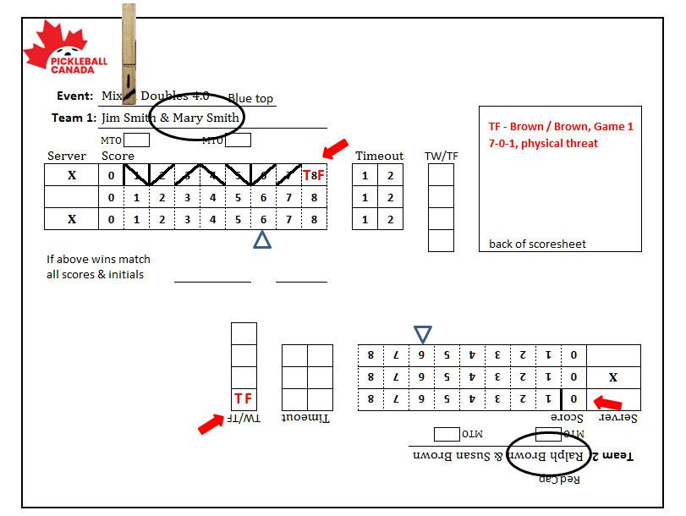
Technical Fouls (cont'd)
One point awarded to non-offending team
Notes:
If offending team has 0 score, add 1 to non-offending team score

Slide 129
Technical Fouls (cont'd)
After awarding point:
Clearly advise team that a point has been deducted from/added to their score – Referee may prompt players into the correct position before calling the score!
Announce “15 Seconds”
After 15 seconds, announce ‘Resume Play’, call score & begin 10 second count

Slide 130
Technical Fouls (cont'd)
After a team has been issued one Technical Foul,
Subsequent Technical Warning will result in Forfeit of the game. (3 strikes)
Two Technical Fouls automatically forfeits the match. (4 strikes)
Notes:
explain 1 strike for TW, 2 strikes for TFs

Slide 131
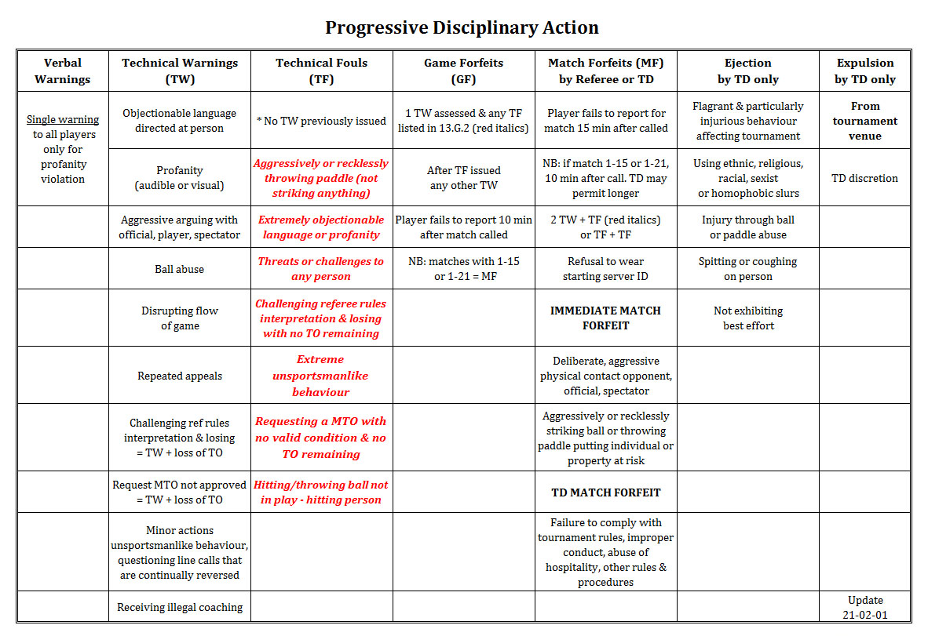
Notes:
131

Slide 132
Questions?

Slide 133
SESSION 2
TOPIC 3
LESS COMMON
ON-COURT
SITUATIONS

Slide 134
Bleeding And/Or Blood On Court
Must be stopped/cleaned up before play resumes
Referee timeout
Not recorded on scoresheet

Slide 135
NVZ Violations (repeated)
Primary responsibility during and following a volley
Includes the player’s momentum
Momentum ends when the player regains balance and control of their motion or stops moving toward the NVZ
Anything the player is wearing, carrying or contacting touches the NVZ
Call Fault immediately

Slide 136
NVZ – More
After being in the NVZ a player cannot legally volley ball until both feet have contacted the playing surface outside the NVZ - pushing off from the NVZ is a violation.
When crossing through the NVZ both feet must contact playing surface outside NVZ before ball can be legally volleyed.
A player nor their equipment can never legally touch the net, post or opponent’s court surface while the ball is in play.
Notes:
Time permitting, view Mark Renneson’s video - Spot the Rule Breaker: https://www.youtube.com/watch?mc_cid=88918e3c86&mc_eid=3a58932751&v=yjNFY7LQt7M&feature=youtu.be

Slide 137
NVZ - More (cont’d)
Crossing the plane of the net is NOT OKAY when:
When player does not make contact with ball
This includes an attempted 'Erne' shot
A foot or toe extends beneath net into opponent’s court

Slide 138
NVZ - More (cont’d)
Crossing the plane of the net is Not a fault:
On follow through of legal hit, including 'Ernes‘
When chasing a bounced ball spinning back over net. Yes, players can break the net plane prior to hitting the ball for this reason only!
Balls with backspin that return back over the net, may be hit by reaching over or under the net, or around the net post.

Slide 139
NVZ - More (cont’d)
R
Foot IN and OUT
Hit now
is OK
Going in and back out of the NVZ
L
L
L
NE
T
Left foot still in air
Hit now not OK
Foot on floor IN
Hit now
NOT OK
L
L
L
R
R
R
L

Slide 140
NVZ - More (cont’d)
R
L
L
R
Foot in and OUT
Hit is now OK
Going across or thru the NVZ
L
NE
T
Jumping across
Hit is OK
Foot stays in
Hit is NOT OK
L
R
R
R
L
L
L
R

Slide 141
Distractions
Declare a Fault immediately if a player deliberately creates
a distraction when an opponent is about to strike the ball; e.g.:
waving paddle or arms
making loud noises or yelling
If a player asks “Wasn’t that a distraction?”, the referee can rule it a fault, but only if they determine it affected the outcome of the rally.

Slide 142
Forfeits
Player is not ready to play within 10 minutes of when match announced = Game Forfeit
Not ready after 15 minutes = Match Forfeit
A player or team receives one Technical Warning and one Technical Foul in a match = Game Forfeit (3 strikes)
An additional TW or TF OR two TFs = Match Forfeit (4 strikes)
Player may chose ‘Retirement’ and the match will be awarded to the opponent.
Notes:
if the match is one game, then forfeit after 10 minutes
The score in all forfeits and retirements is 11-0 or 15-0 for all games
“Progressive Penalties”
142

Slide 143
Forfeits (cont’d)
Other behaviours that will result in immediate match forfeit:
making deliberate, aggressive physical contact with any person;
striking or throwing a paddle or ball that endangers a person or property
Player refuses to wear designated starting server identification band
If during a match, a player is discovered to be playing with a paddle that is not approved
Notes:
if the match is one game, then forfeit after 10 minutes
143

Slide 144
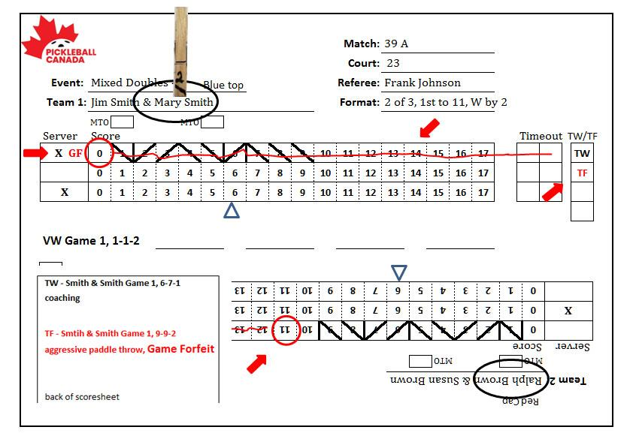
Forfeits (cont’d)
Document a Game Forfeit
Notes:
if the match is one game, then forfeit after 10 minutes
144

Slide 145
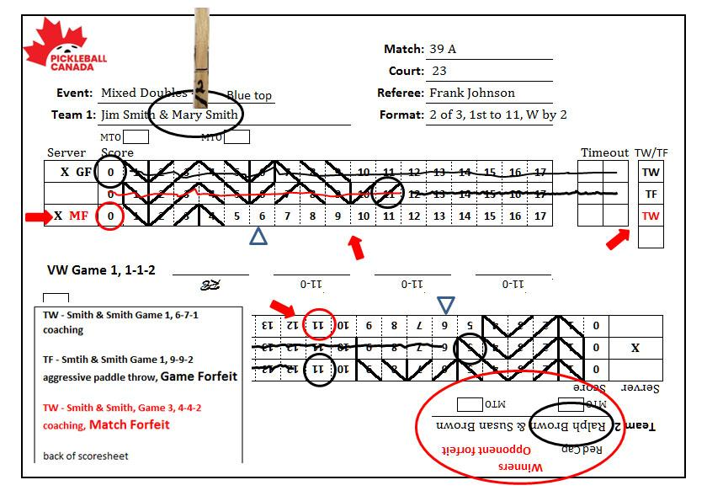
Forfeits (cont’d)
Document a Match Forfeit
Notes:
if the match is one game, then forfeit after 10 minutes
145

Slide 146
Unruly Players
Remain calm, maintain an open mind
Meet players mid-court, away from spectators
Issue Technical Warning/Foul (based on severity) if player continues to create problems
Tournament Director has option to eject (from the tournament) or expel (from the tournament grounds)
Notes:
Eject = done playing in tournament
Expel = done and must leave the grounds immediately

Slide 147
Hearing Impaired Players
Accommodate requests to announce score extra loud
Be sensitive and tolerant of player asking to repeat score
Look toward impaired player when announcing score
Enunciate extra clearly
Consider using extended finger(s) for score, if necessary

Slide 148
Wheelchair Rules
The chair is considered part of player’s body
Balls may double bounce, including out of the court on the second bounce
Only the larger rear wheels will cause a NVZ fault when hitting a volley or a fault when serving

Slide 149
Questions?

Slide 150
SESSION 2
TOPIC 4
DUAL REFEREE
SYSTEM

Slide 151
Dual Referee System
Goals
Increase accuracy of NVZ calls & crossing plane of he net.
Support the Lead Referee in ALL aspects
To assure the accuracy of Referee Calls

Slide 152
Dual Referee System
Lead Referee Responsibilities
Makes final decisions on calls
Focus on server complying with service motion elements, and proper ball release.
Lead Referee to check the readiness of 2nd Referee after breaks in play.

Slide 153
Dual Referee System
Second Referee Responsibilities
Assist the Lead Referee in calling NVZ and plane of the net violations, on both sides of the net.
Assist in observing all player activities on & around the court, esp. at breaks in play.
Maintain control of the ball between games

Slide 154
Dual Referee System
Second Referee Responsibilities
Immediate Calls
NVZ Faults
Plane of the net faults
Service foot faults
Short Serves
Player Safety issues
Double Bounces
Player hit by ball
Ball Carries

Slide 155
Dual Referee System
Second Referee Responsibilities
Signal Violations – Raise the hand after rally
Players out of position
Incorrect server or receiver
Paddle thrown by player
Ball deliberately damaged by player
Unsportsmanlike behaviour
Service motion violations
Server applying spin to the ball
Coaching by a spectator

Slide 156
Dual Referee System
Second Referee Responsibilities
Positioning
Stand on the opposite side of the net
Join Lead Referee at centre of court during breaks in play.
Scorekeeping
2nd Referee does not maintain a scoresheet

Slide 157
Dual Referee System
Second Referee Responsibilities
Appeals
All directed to the Lead Referee
If unsure of call LR will ask 2nd Referee
2nd Referees call will stand after being asked
Conflicting Calls
Lead Referee to call a “Referee TO and discuss with 2nd at centre court.
If overruling a 2nd Referee call – a replay maybe required

Slide 158
Dual Referee System
Second Referee Responsibilities
Pre-match Briefings
Referee
Prior to the Player briefing the Lead Referee shall brief the 2nd Referee on expectation.
Players
Lead Referee to explain the Dual Referee system
Role of 2nd Referee
All questions & appeals directed to Lead Referee

Slide 159
Dual Referee System
Second Referee Responsibilities
Positioning
Stand on the opposite side of the net
Join Lead Referee at centre of court during breaks in play.
Scorekeeping
2nd Referee does not maintain a scoresheet

Slide 160
SESSION 3
THREE TOPICS
Working with Line Judges
2024 Rule Changes
Trainee to Accredited Referee

Slide 161
SESSION 3
TOPIC 1
WORKING
WITH
LINE JUDGES

Slide 162
Line Judge Responsibilities
Characteristics Line Judges need to possess;
Good understanding of Pickleball & the general rules
Work under pressure and make split-second decisions
Sometimes at crucial moments in key matches
Concentrate for extended periods
Ability to make LOUD calls & able to STOP play

Slide 163
Line Judge Responsibilities
Line Judges are required to follow a code of conduct;
Make all calls impartially, fairly, & consistently
Use a professional & pleasant demeanour
Treat everyone with respect
Do NOT be over friendly with players
Do NOT comment on play of either team
Devote full attention to the match
At T/O you are still on duty, watch the players
DO NOT speak with anyone during the match
All personal electronic devices are off
Do NOT use earbuds or any device that might appear to be distracting
Do NOT Line Judge, relatives, close friends or doubles partners.

Slide 164
Line Judge Responsibilities
Can be a great benefit to Referees and Players, IF they perform their duties correctly!
IF NOT – They can be a huge distraction to both Referees and the Players.
LJ’s have an important function and need to be focused at ALL TIMES!

Slide 165
Line Judge Responsibilities
Line Judges should never get into a dialog with a player or respond to their questions, in any way.
Referees should ensure that Players do not interact with the Line Judges
Referees are to ensure that all questions related to Line Judge’s calls are addressed to them.
Referees have the authority & responsibility to replace any LJ not performing to standard.

Slide 166
Line Judge Responsibilities
Are part of the officiating team
Can do more than call lines
Are a Referee’s second set of eyes & ears
Referee is responsible for briefing Line Judges
DO NOT let Referees influence your training
Make ALL CALLS as trained!!

Slide 167
Line Judge Responsibilities
Remain attentive
Make “Out” calls on assigned line(s)
Call “Foot Fault” on baseline, if assigned
Provide opinion when asked by Referee
When asked, let Referee know that you are 100% sure, or NOT SURE!

Slide 168
Line Judge Responsibilities
Line Judge – Options and Positioning
TD/HR determine Line Judge formation
4 LJ’s – 1 for each baseline & sideline
Passive LJ option
Positioning of LJ is Referee responsibility, BUT
TD/HR to determine if conditions require LJ to sit.

Slide 169
Pre-Match Line Judge Briefing
Instruct Line Judges to:
Turn off cell phones
Remain attentive and avoid DO NOT get into side conversations
Follow play and be prepared to offer opinion if asked by Referee
Avoid DO NOT being influenced by spectator or player line calls

Slide 170
Pre-Match LJ Briefing (cont'd)
Respond to every “Out” ball on assigned line:
Verbally – Call “OUT” – loudly
Visually – outstretched arm at 45° angle
Signal view blocked - with hands under both eyes
When a ball is close, but “IN”
Signal with both arms extended forward and downward, hands overlapped, palms down
NO verbal call

Slide 171
Pre-Match LJ Briefing (cont'd)
Call service foot Faults - loudly!
Baseline judges: baseline & extended side & centre lines
Sideline judges: extended sideline
Call - ”FOOT FAULT” & then raise hand and hold for 5 seconds.

Slide 172
Pre-Match LJ Briefing (cont'd)
During match, confirm each Line Judge’s readiness at:
Start of each game
Before resuming play after:
All Official Breaks in play
Any extended break in play – Technical Warnings/Fouls
Line Judges should respond at once “READY”and raise hand in 45° angle.

Slide 173
New Line Judge Signals in 2024
Open palm of one hand and with the fist of the other, brush across palm twice to indicate that the ball bounced twice before being played by the player.
Open palm of one hand, brushed by palm of other hand to indicate that the ball brushed a piece of clothing or was struck twice by a team.

Slide 174
Player Pre-match Briefing
Advise players:
Referee calls served balls that do not clear the NVZ
Players call centre line
Line Judges call all other lines
Explain
Right of appeal
Unseen ball is “In”

Slide 175
Line Judges
Line Calling Mechanics
Watch the BALL and its flight to determine if it has double bounced, struck a player or their clothing, or has been hit by both players before going over the net!
If you see that one of those situation has occurred, make the appropriate hand signal or get the Referees attention prior to the next rally!
DO NOT let it go uncalled!

Slide 176
Line Judges
Line Calling Mechanics
When it looks like a Player may be hitting a ball towards your line, move your head and eyes to a position so that you are looking down the line prior to the ball arriving!
Focus on the edge of the line and the playing surface!
Remember that if the ball contacts the line it is IN and you need to make the appropriate hand signal.
If the Ball is OUT, call out sharply and immediately!
Loud enough to immediately STOP PLAY!

Slide 177
Line Judges
Line Calling Mechanics
Then raise your hand in a 45° angle and hold for 5 sec.
If you cannot determine that the ball is OUT, it must be signalled IN, and play allowed to continue… ready to make another call!
All balls that are hit OUT must be called out after the bounce, regardless of how far OUT they are hit!
NOTE: Balls that do not cross the plane of the net, do NOT require an LJ’s OUT Call.

Slide 178
Line Judges
Referee shall canvass other LJ’s to see if they can make a call.
If Line Judges and Referee cannot make a line call, the rally shall be replayed.
If the Referee overrules the Line Judge’s ‘Out’ call as IN, the rally shall be replayed, unless conceded by the benefitting team.

Slide 179
Line Judges
Line Calling Mechanics
Percetual Mislocalization
The researchers identified 83 missed calls during the 2007 Wimbledon tournament. (Some were challenged by players and overruled, and others were later identified as unquestionably wrong through frame-by-frame video.) Seventy of those 83 calls, or 84 percent, were on balls ruled out — essentially, shots that line judges believed had traveled farther than they actually did.
Called perceptual mislocalization by vision scientists, this subconscious bias is known less formally to Wimbledon fans as “You cannot be serious!” — John McEnroe’s infamous dissent when, yes, a 1981 shot was ruled out.

Slide 180
It is all about increasing:
Competency
Standardization
Consistency
Professionalism

Slide 181
Be Professional & Competent
The match is about the players and
the game, NOT the Officiating Team
The most successful TEAM is the one
no one remembers after the match!

Slide 182
2024
USA Pickleball
Rule Changes
27 Approved Changes
Reviewing 13

Slide 183
2023 (August) Rules Changes
Player Position - 4.B.9
DO NOT Call the score until you have verified that ALL players are in the correct position.
If they are not, tell them their correct position and allow them time to move into position.
If you see a player questioning their position or if they are the correct server, step in and tell them where they should be.

Slide 184
2023 (August) Rules Changes
Player Position - 4.B.9
If the Referee and the players do notice an incorrect server/position until after the rally is completed… the rally stands as played.
If a player stops play to question an incorrect server/position at any time in a rally and they are correct… the rally will be replayed.
If a player stops play and is incorrect… it is a FAULT

Slide 185
2024 Rules Changes (cont’d)
DRAPING NET – 2.C.6/11.L.5.b
Previously the rule allowed for the Referee to use discretion in determining if a ball that went over the net (not on the server) and made contact with a draped net on the court. Did it affect the play?
Now NO Discretion – Replay shall take place
Notes:
Time permitting, show Don Stanley video: https://www.facebook.com/don.stanley2/videos/10224333164307386/

Slide 186
2024 Rules Changes (cont’d)
DRAPING NET – 11.L.5.b
Rule 11.L.5.b for temporary nets now calls for a replay without qualification.
If the ball goes over the net and;
Hits the centre base
Hits any part of the horizontal bar
The ball gets caught between the net and bar
Hits a deflecting net (windblown)
Hits a draping net on the ground
Notes:
Time permitting, show Don Stanley video: https://www.facebook.com/don.stanley2/videos/10224333164307386/

Slide 187
2024 Rules Changes (cont’d)
Catch or Carry Ball on the Paddle (7.L)
The rule now makes catching or carrying a ball on the paddle a FAULT without having to determine that the catch or carry was deliberately done!
Explanation – The ball remains on the paddle for an extended period of time. i.e. It does not immediately bounce off the paddle in the opposite direction from which the paddle was facing – Carried along the paddle!

Slide 188
2024 Rules Changes (cont’d)
Double Hits (11.A) – Removal of “Deliberately”
Balls can be hit twice, but this must occur during a continuous, single-direction stroke by one player.
If the stroke made while performing the serve or during a rally is not continuous, or not in a single direction, or the ball is struck by a second player, it is a fault.

Slide 189
2024 Rules Changes (cont’d)
Broken, Cracked, Degraded, or Soft Ball (11.E)
Play continues to end of rally.
Players may appeal to Referee, to determine if ball was broken or cracked and effected play.
If determined it did – REPLAY
Ball may be changed if BOTH teams agree ball is soft, or degraded – NO REPLAY

Slide 190
2024 Rules Changes (cont’d)
CONCEEDING A RALLY (13.E.4/13.E.5)
Rule 13.E.4 calls for a replay when the Referee overturns a line judges ”OUT” call as “IN”.
The team that benefited from the overrule can now concede the rally to their opponents if they determine they would have been unable to return the ball.

Slide 191
2024 Rules Changes (cont’d)
CONCEEDING A RALLY (13.E.4/13.E.5)
Rule 13.E.5 calls for a replay when a player overrules to their detriment a line judges out call, as ”IN”.
The player/team may now choose to concede the rally to their opponents if they determine they would have been unable to return the “IN” ball.

Slide 192
2024 Rules Changes (cont’d)
MEDICAL TIME OUTS (Rule 10.B.2.c)
Players now allowed to use available Time-Outs after the 15-minute medical time-out has expired to allow for more time before the player must have to retire from the match!

Slide 193
2024 Rules Changes (cont’d)
ILLEGAL PADDLES – Non-Officiated Play
In Tournament Play, in a non-officiated match, players are now able to go to the HR or TD if they feel that their opponents paddle is illegal in any way!

Slide 194
2024 Rules Changes (cont’d)
PADDLE SPECIFICATIONS (Rule 2.E.2./2.E.5.a./2.E.5.c.)
Paddle specifications have been updated to address new and emerging paddle technology and features and to clarify the alterations that players are allowed to make to certified paddles!

Slide 195
2024 Rules Changes (cont’d)
PADDLE SPECIFICATIONS
(Rule 2.E.2./2.E.5.a./2.E.5.c.)
2.E.2 – Surface shall not contain, delamination, holes, cracks rough textures or indentations that break the skin or surface, allowing players to impart excessive spin on the ball.
2.E.5.a – Alterations or additions to paddles may include; edge guard tape/replacements, weighted tape, weights for an OEM integrated weight system, changes to grip size via inserts, grip wraps, OEM interchangeable grips, OEM replacement paddle faces, and name decals and/or other identification marking on the paddle face.
2.E.5.c – The only permissible handwritten pen markings allowed on the paddle’s playing surface must be for identification purposes only (name, signature, phone #, email address.) No aftermarket graphics are allowed on a commercially made paddle.

Slide 196
2024 Rules Changes (cont’d)
MINI SINGLES (Rule 12.O.)
Mini Singles now an approved format!
Rules incorporated into the 2024 Rulebook.

Slide 197
2024 Rules Changes (cont’d)
NET - 11.L.5.b.
Except on the serve, a replay shall occur if the ball goes over the net and;
Hits the Centre Base
Hits the Horizontal Bar
Ball get caught between the net & Horizontal Bar
Hits a Billowing Net
Hits a Draping Net on the Ground

Slide 198
2024 Rules Changes (cont’d)
END CHANGE 5.B.3.
In a 2 out of 3 match, when the 1st game in the match was FORFEIT as a result of later arrival
No END CHANGE at 6 pts in the 3rd game.
APPEALS – 13.F.3.
Only rally-ending line calls may be appealed
Prior to the next serve

Slide 199
SESSION 3
TOPIC 3
NAVIGATING
OFFICIATING PAGES
PC WEBSITE

Slide 200
OFFICIATING PAGES - Overview
PC Officiating Program – Overview
De-Accreditation/Certification – Code of Conduct
Officiating Organization Chart
Rulebook
Officiating Handbook (Best Practices)
Casebook
Assessments - RAF

Slide 201
Questions?

